Slide 1
Thermal Neutron Simulation From Different Geometries
Tushar Verma
Department of Chemical Engineering, Indian Institute of Technology Kanpur, 208016, India
tuhar22@iitk.ac.in, tusharverma218@gmail.com

Slide 2
Introduction
Monte Carlo Simulation:
Computation technique to estimate possible outcomes of a process, using repeated random sampling.
Cross Section and Mean Free Path data for thermal neutrons (E ~ 25.3 meV):
Table 1. JANIS cross section data for thermal neutrons.
Table 2. Calculated mean free path for thermal neutrons.
 | Absorption | Scattering
 | σ (cross section, barns) | σ (c.s., barns)
¹H | 0.332 | 20.491
²D | 0.000506 | 3.390
⁸O | 0.000190 | 3.761
 | Absorption | Scattering
 | λ (mean free path, cm)
H₂O | 45.1766 | 0.6706
D₂O | 24994.0175 | 2.8501

Slide 3
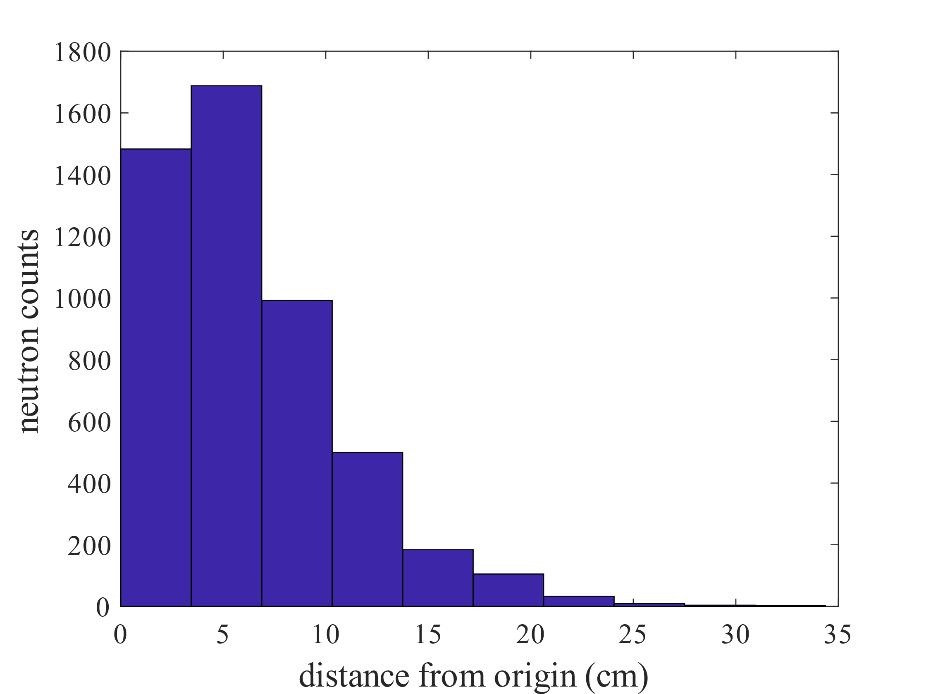
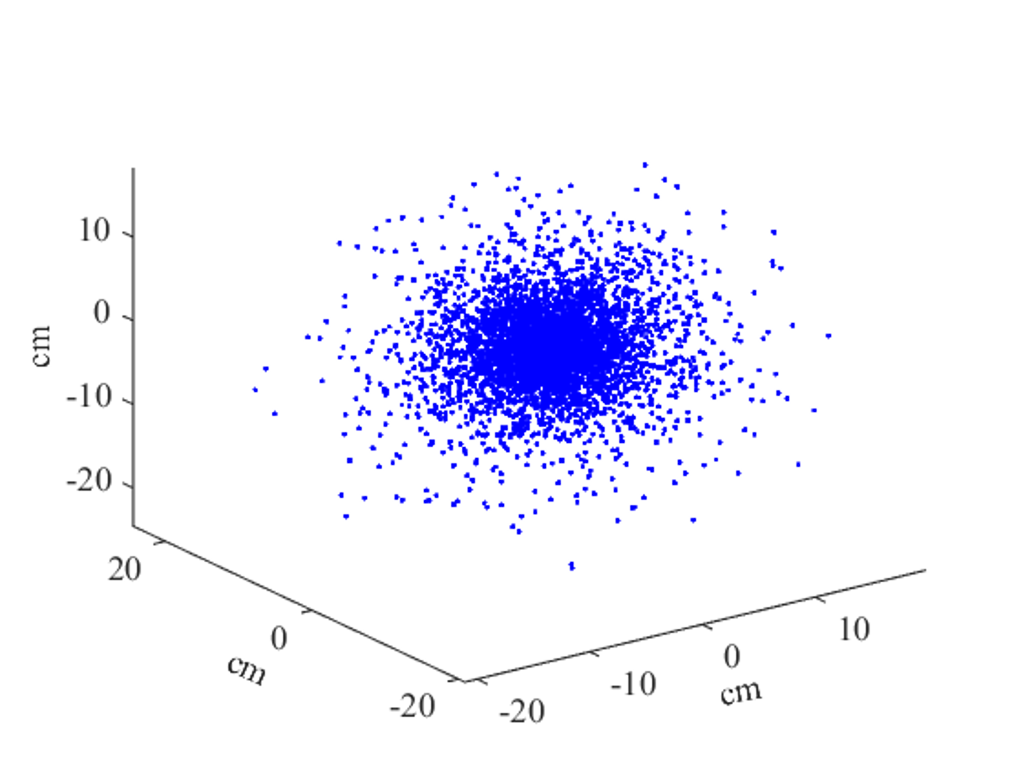
Point Source @ (0,0,0): H₂O
MC simulation for 5K neutrons, for 25 such data:
Scattering counts before absorption (aka n history): 68.2748 ± 0.7224
Mean of neutron distance: 6.2716 ± 0.0512 cm
Maximum neutron distance: 38.2243 ± 5.7061 cm
Maximum neutron counts

Slide 4
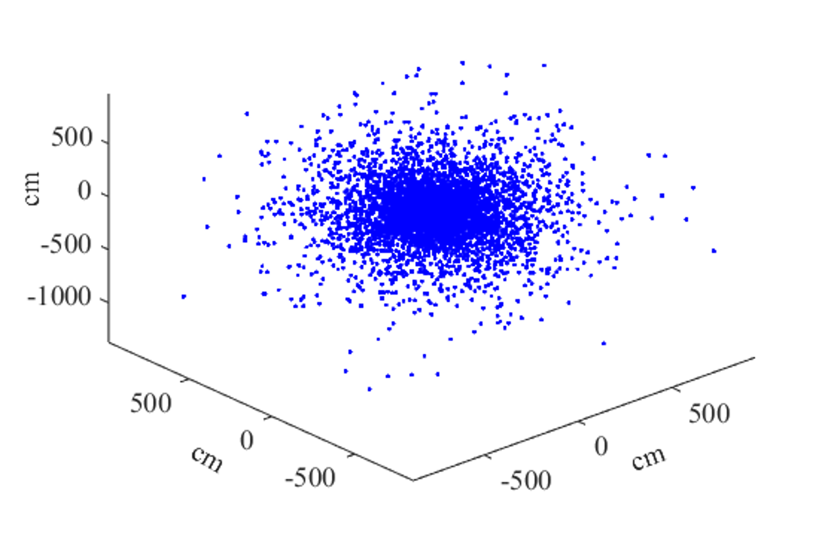
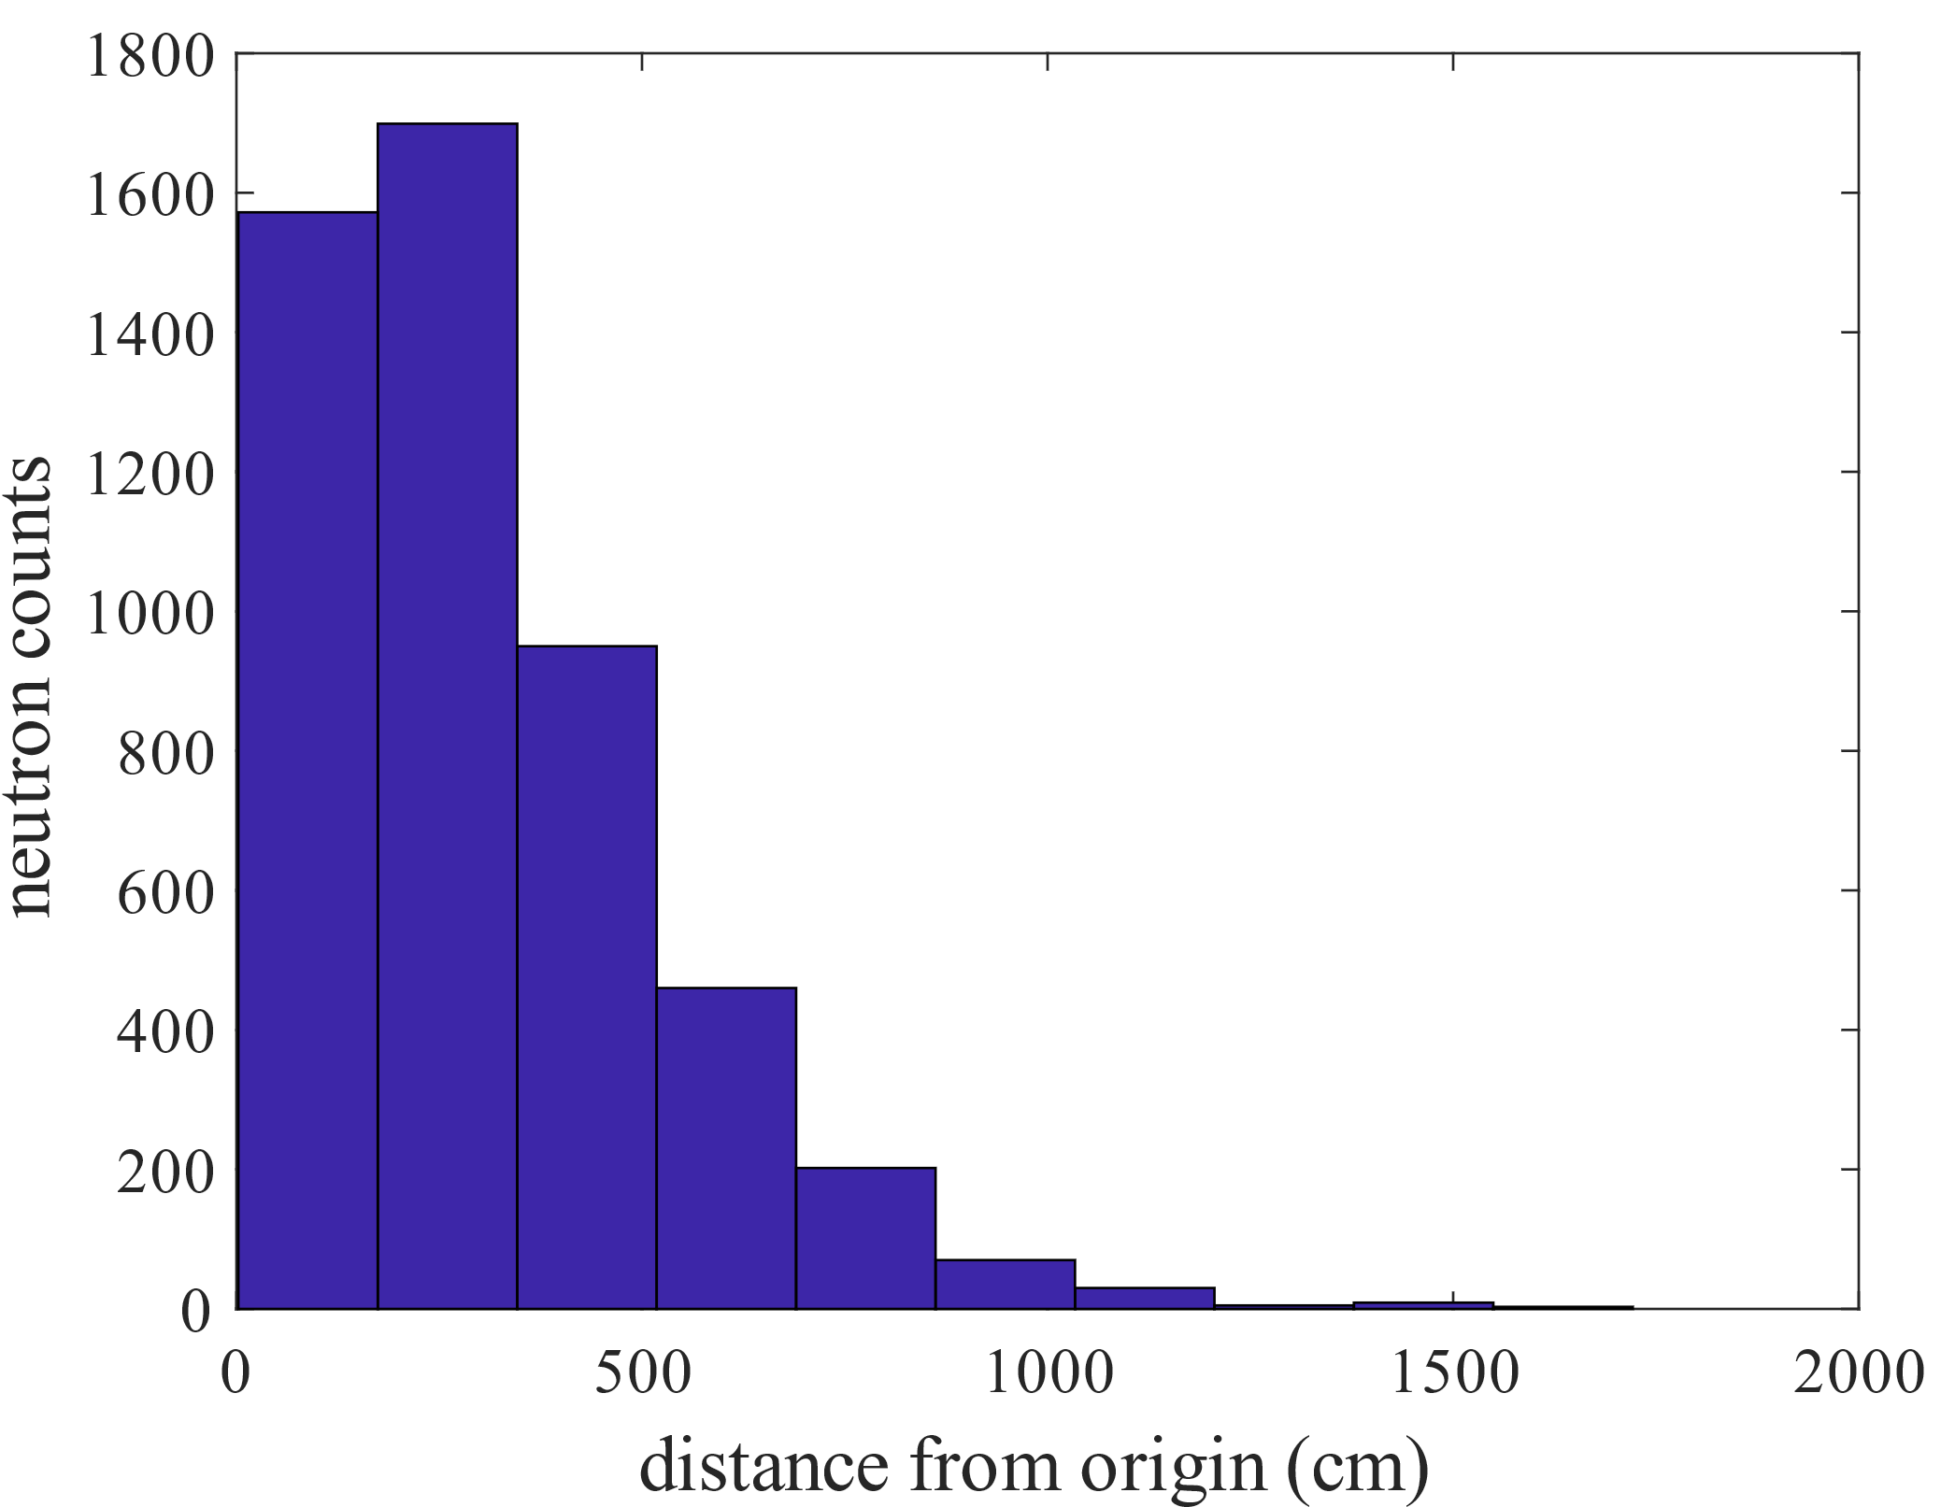
Point Source @ (0,0,0): D₂O
MC simulation for 5K neutrons, for 25 such data:
Scattering counts before absorption (aka n history): 8795.1912 ± 138.0917
Mean of neutron distance: 308.5265 ± 2.8019 cm
Maximum neutron distance: 1793.4059 ± 218.9170 cm
Maximum neutron counts

Slide 5
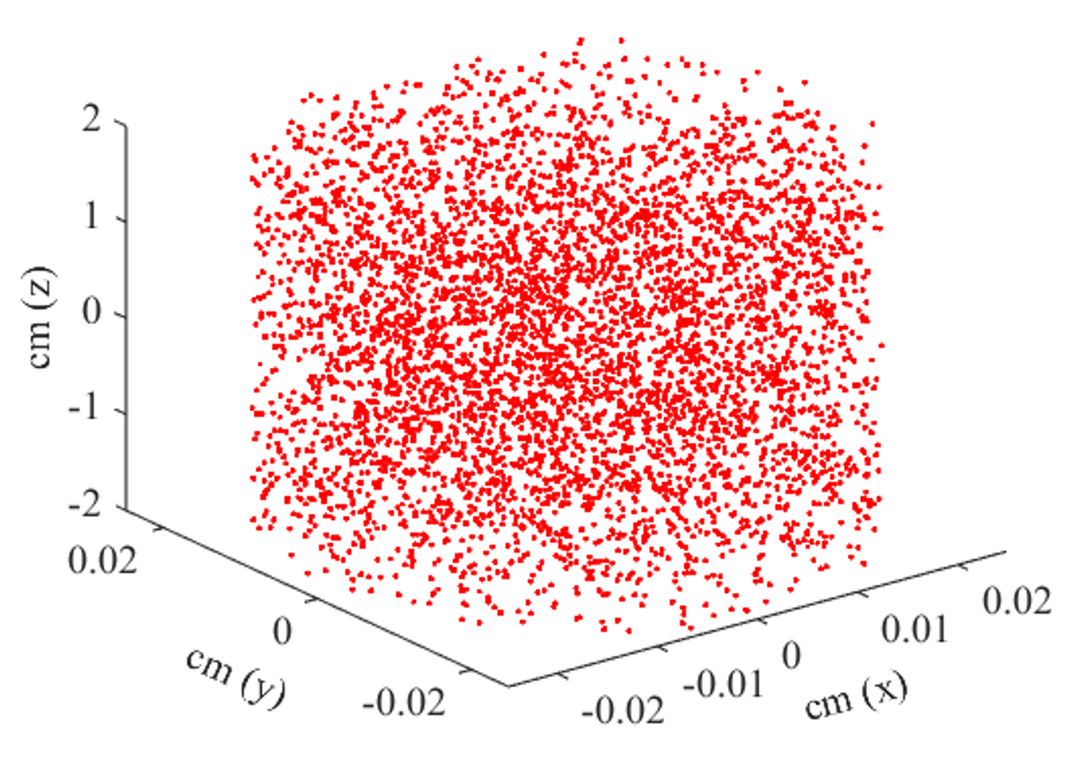
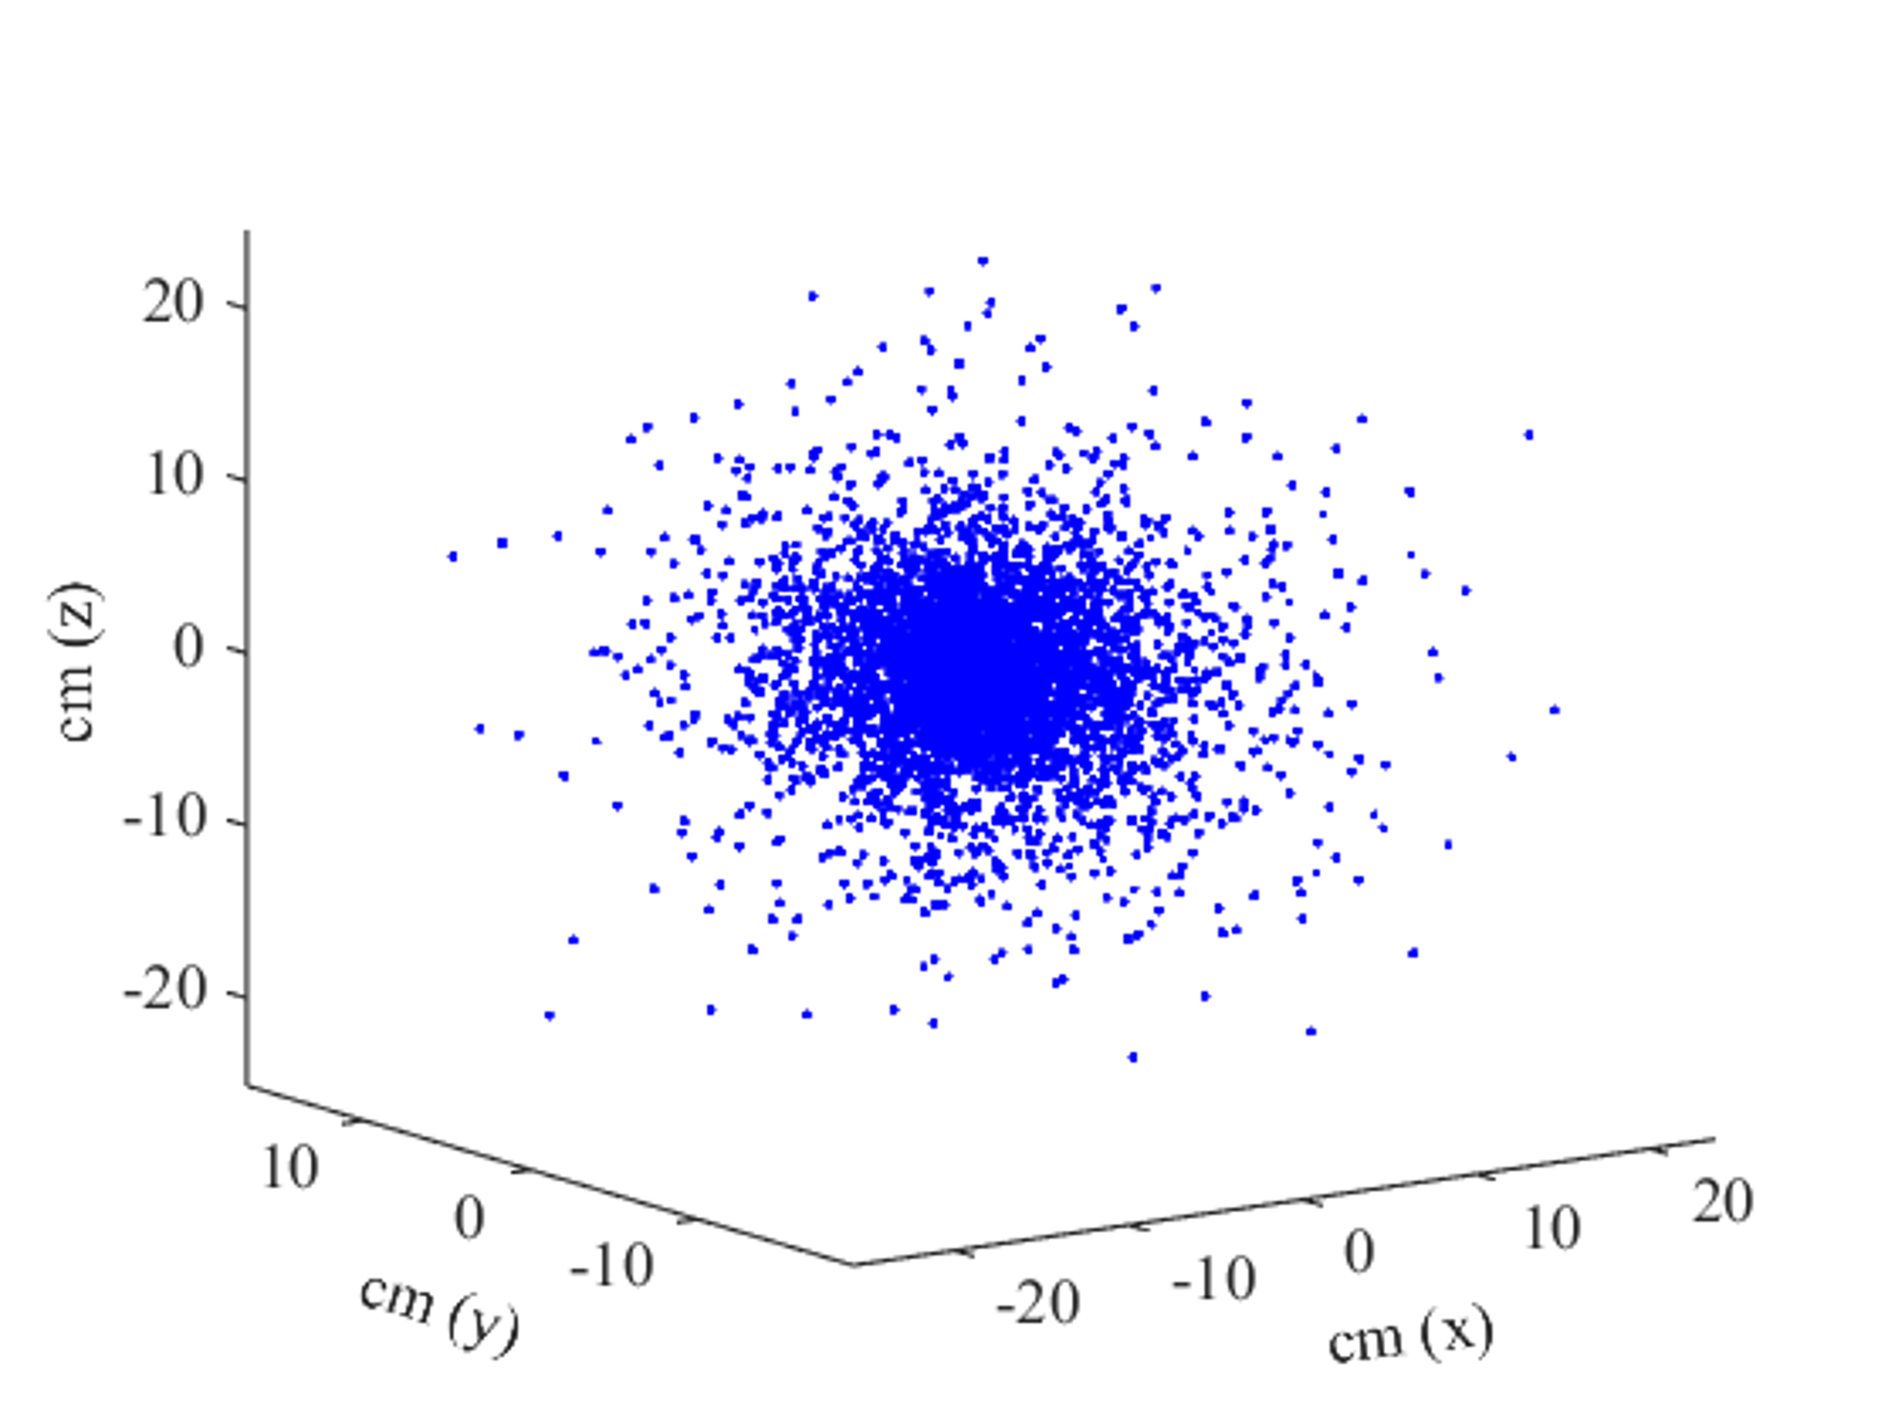
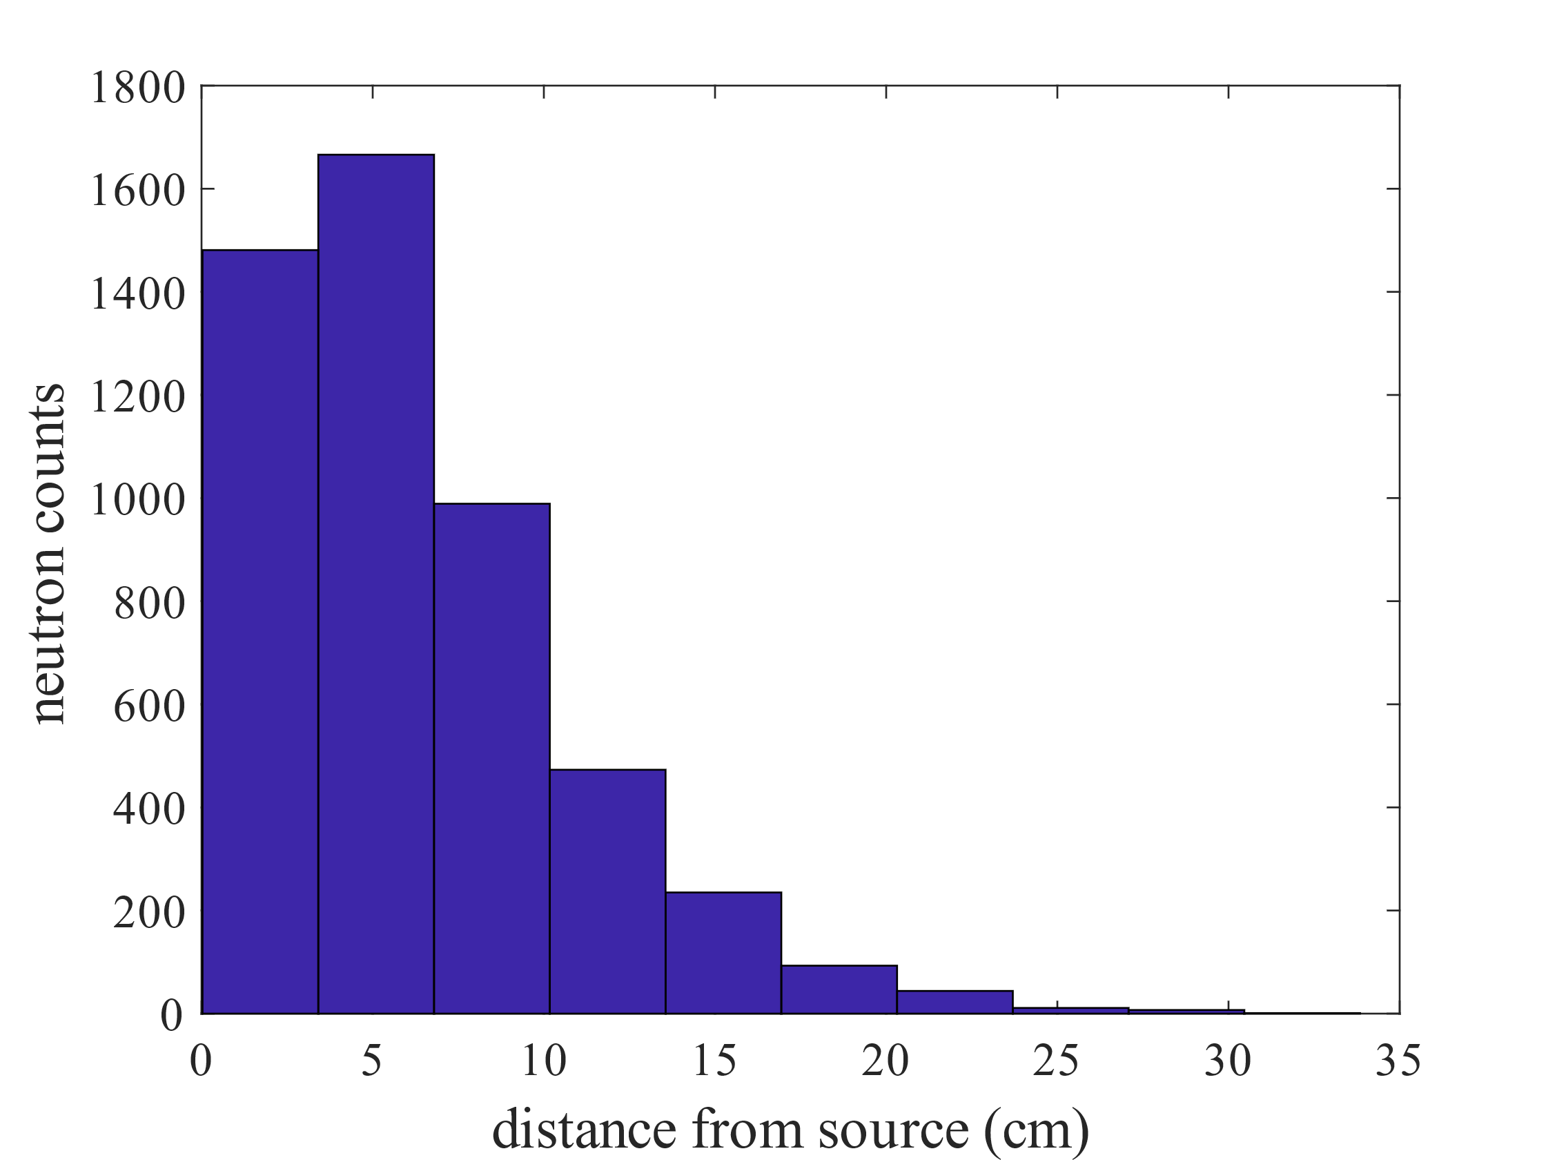
Cylinder Source @ (h = 4cm z:[-2,2], d = 0.5 mm): H₂O
MC simulation for 5K neutrons, for 25 such data:
Scattering counts before absorption (aka n history): 68.3475 ± 1.0078
Mean of neutron distance: 6.2818 ± 0.0613 cm
Maximum neutron distance: 37.5690 ± 3.9512 cm
Maximum neutron counts

Slide 6
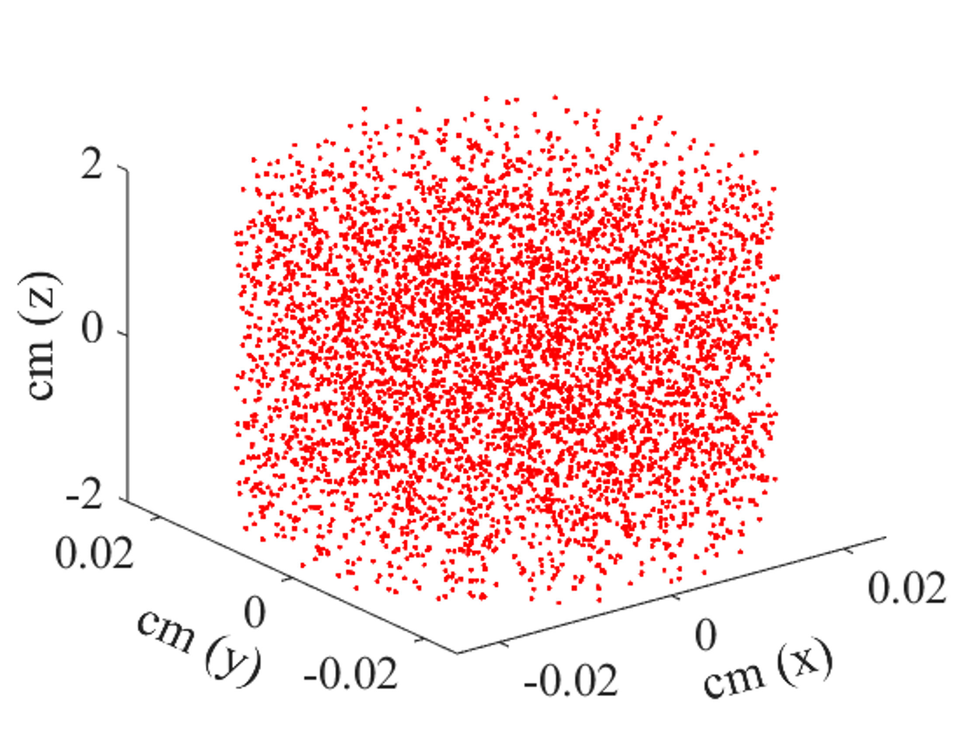
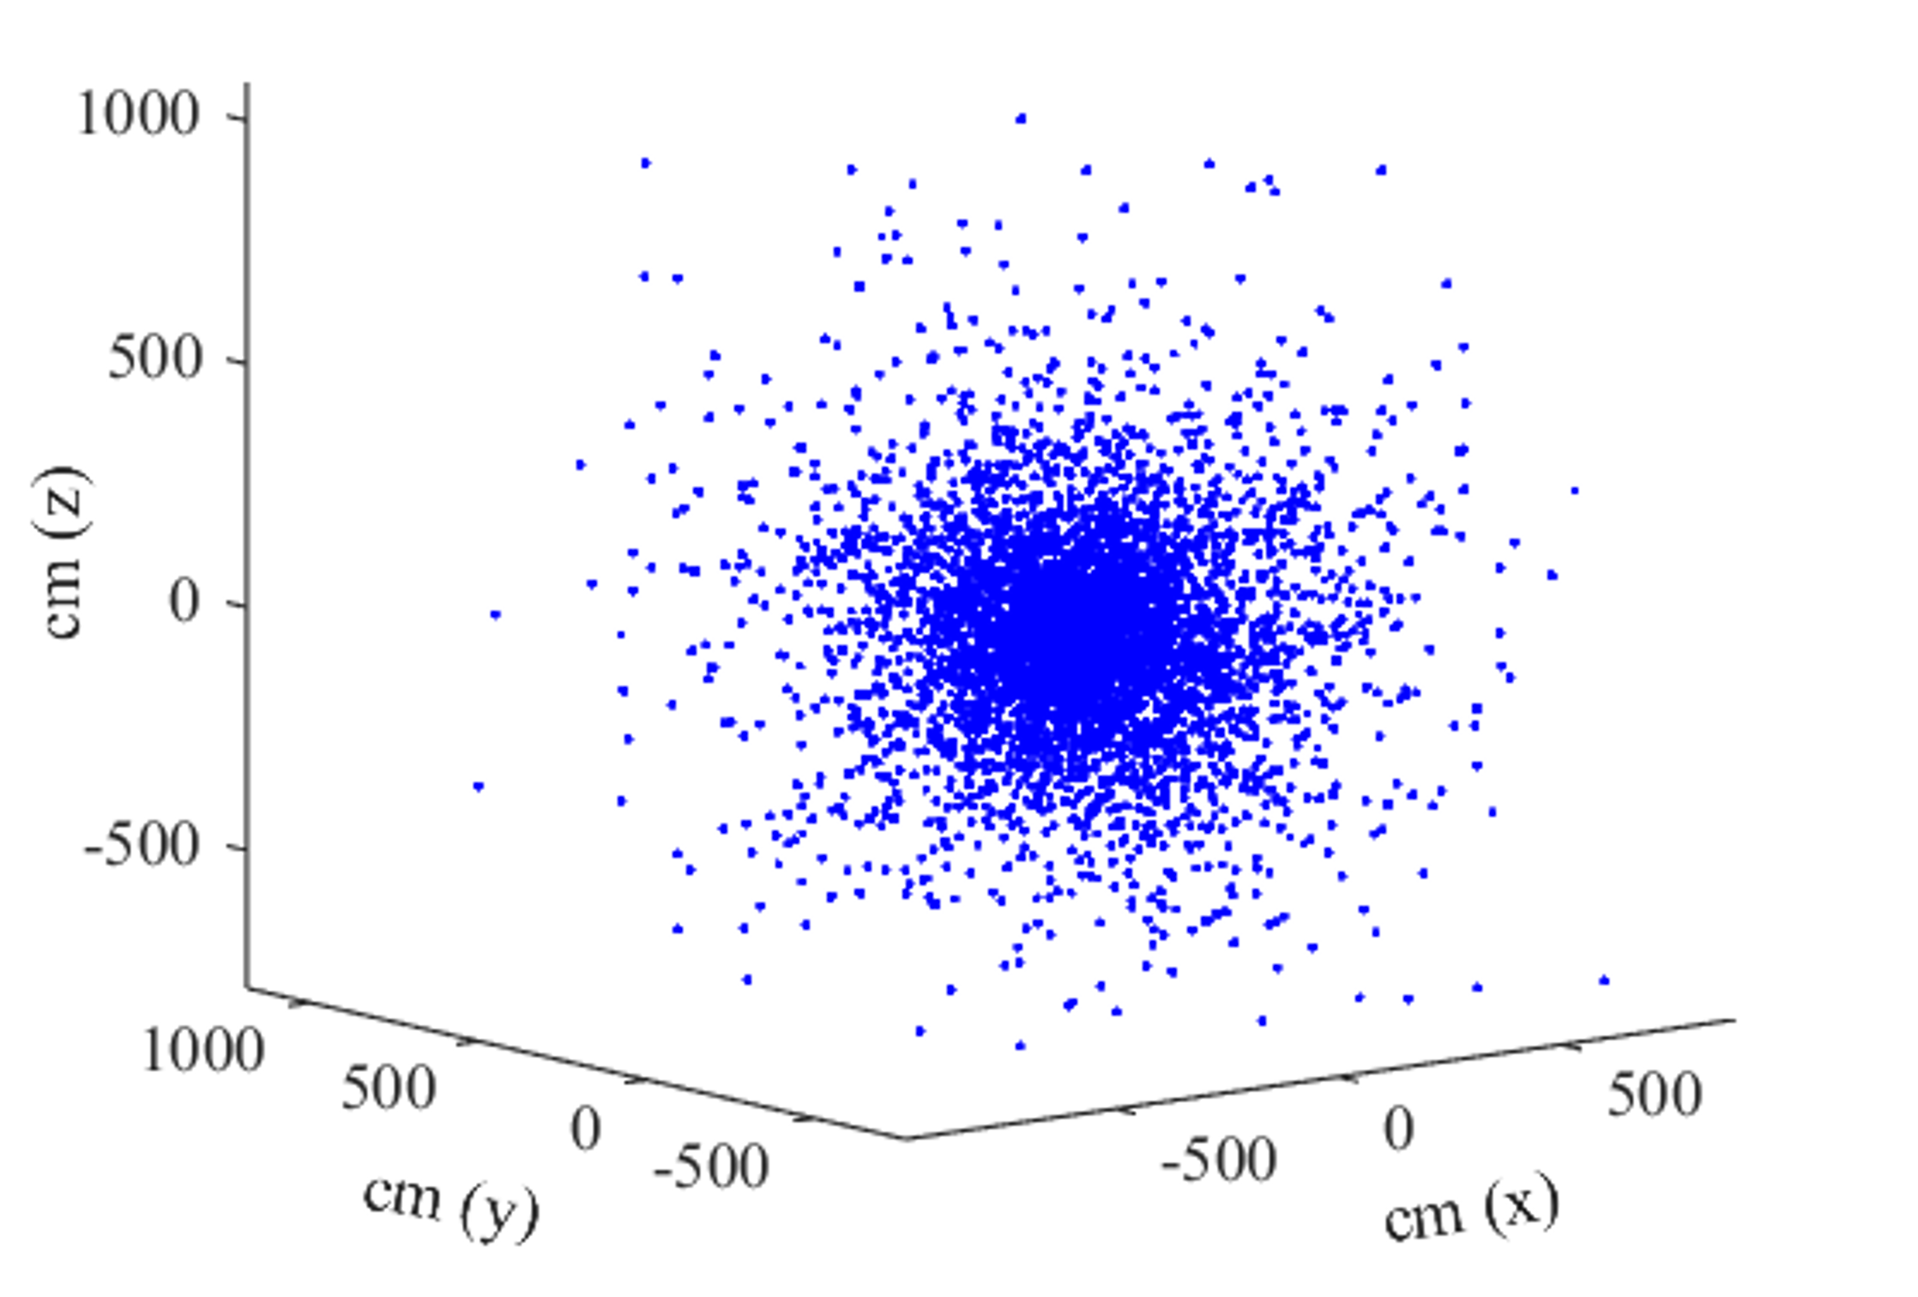
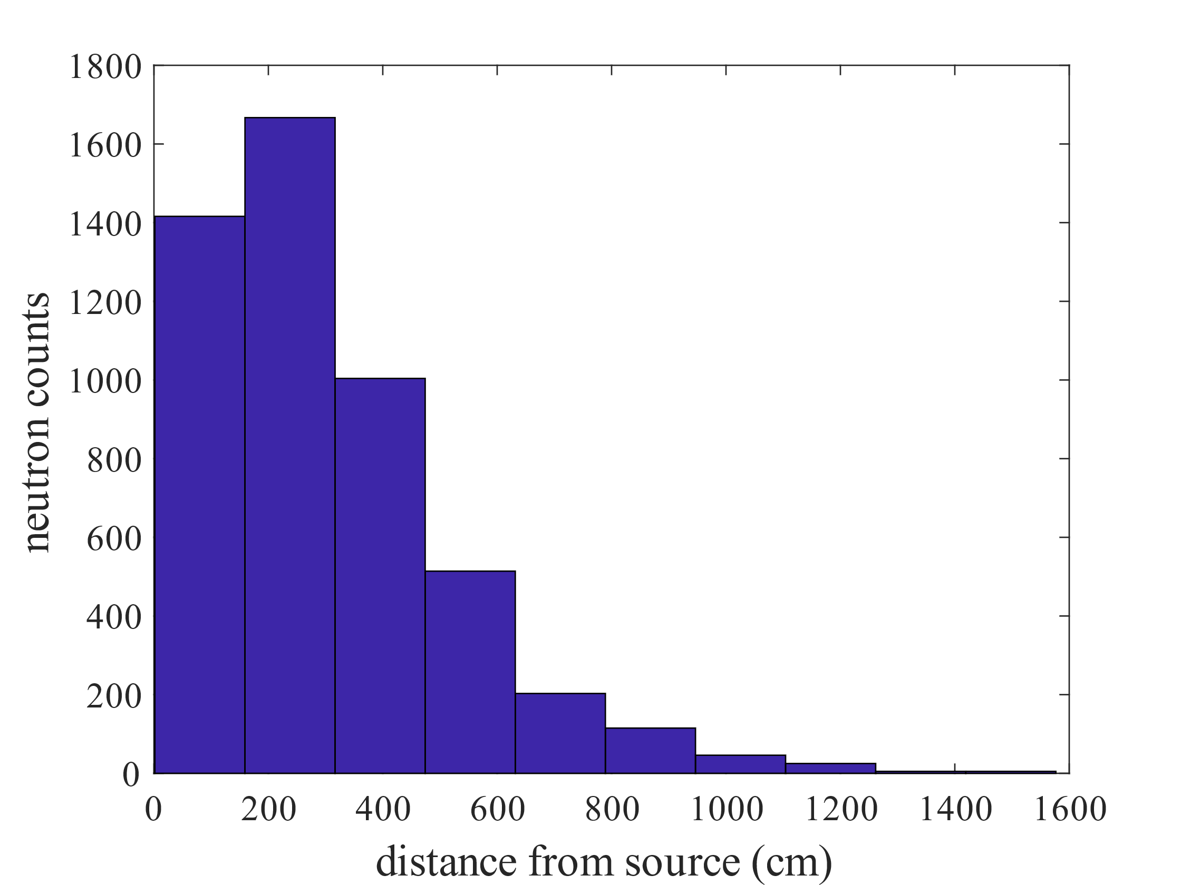
Cylinder Source @ (h = 4cm z:[-2,2], d = 0.5 mm): D₂O
MC simulation for 5K neutrons, for 25 such data:
Scattering counts before absorption (aka n history): 8771.1276 ± 117.2476
Mean of neutron distance: 308.1507 ± 3.1943 cm
Maximum neutron distance: 1819.5574 ± 241.4102 cm
Maximum neutron counts

Slide 7
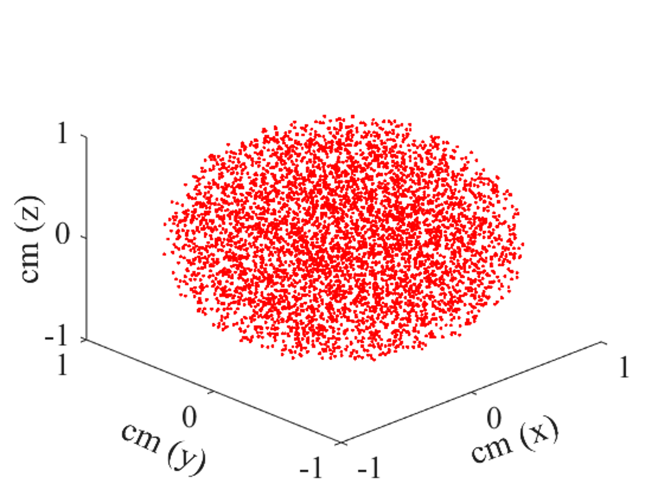
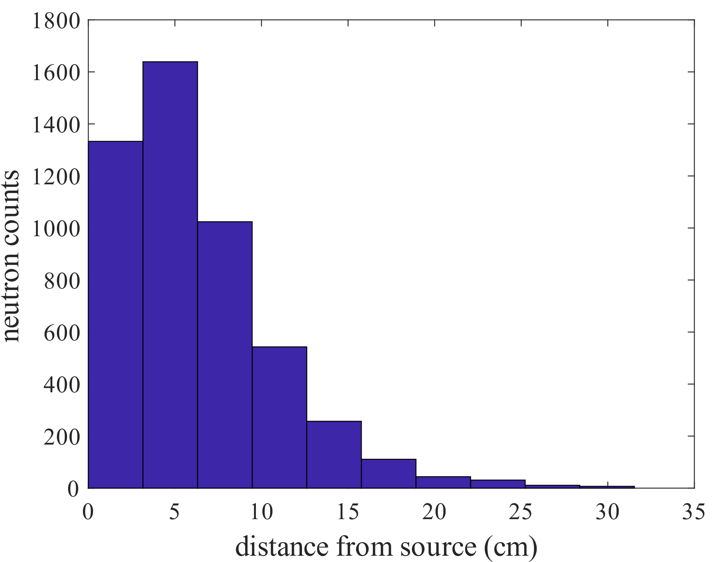
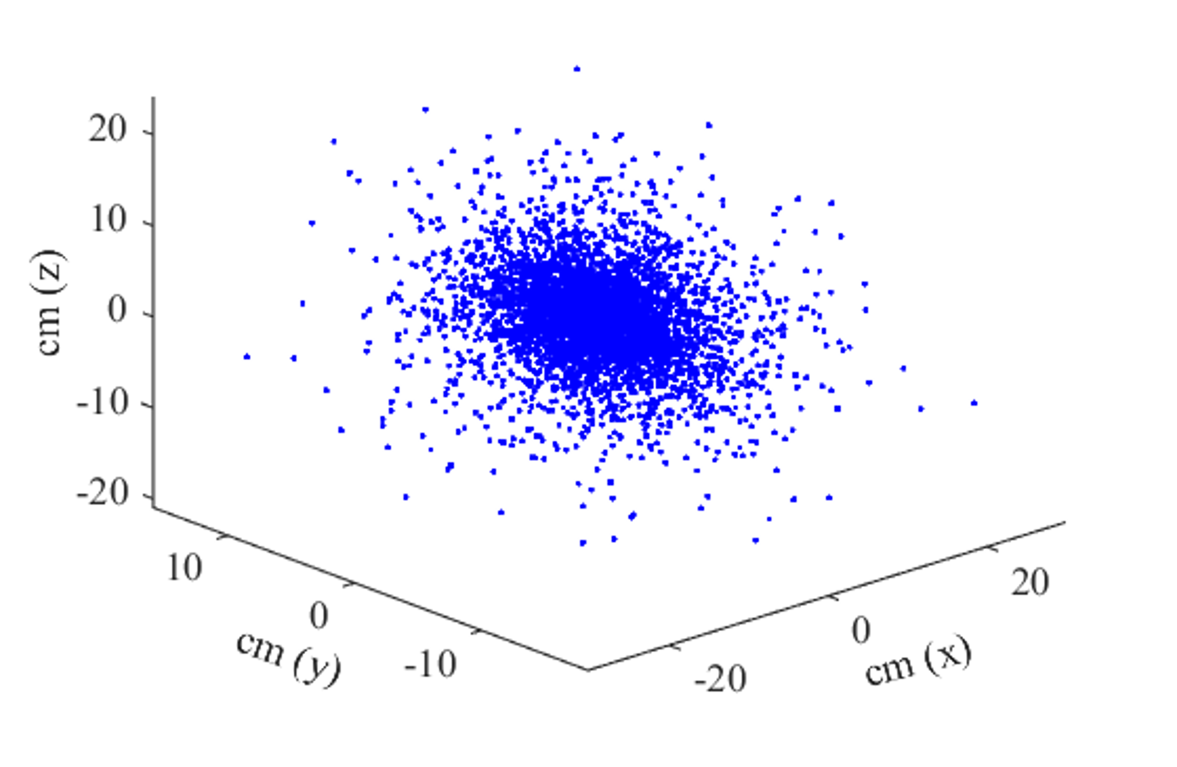
Spherical Source @ (r = 1cm & c:[0,0,0]): H₂O
MC simulation for 5K neutrons, for 25 such data:
Scattering counts before absorption (aka n history): 68.4373 ± 0.9366
Mean of neutron distance: 6.2874 ± 0.0555 cm
Maximum neutron distance: 37.5249 ± 5.0371 cm
Maximum neutron counts

Slide 8
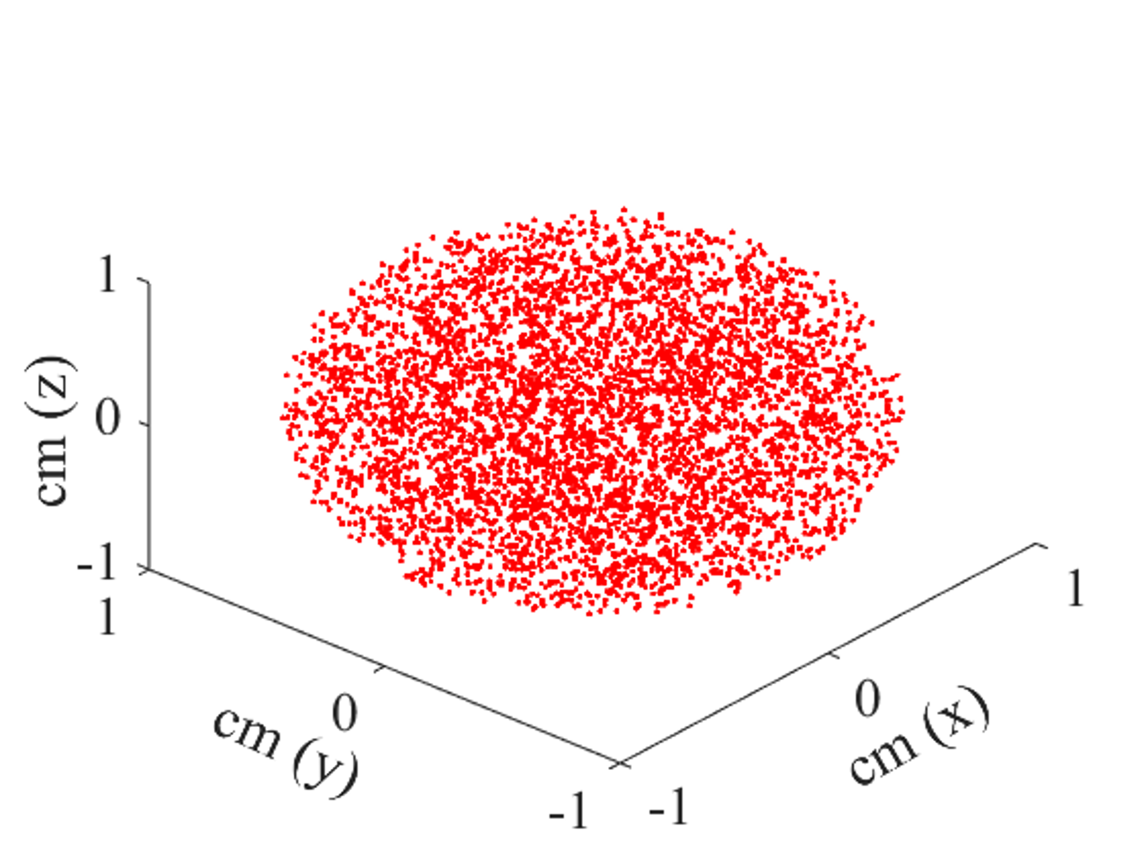
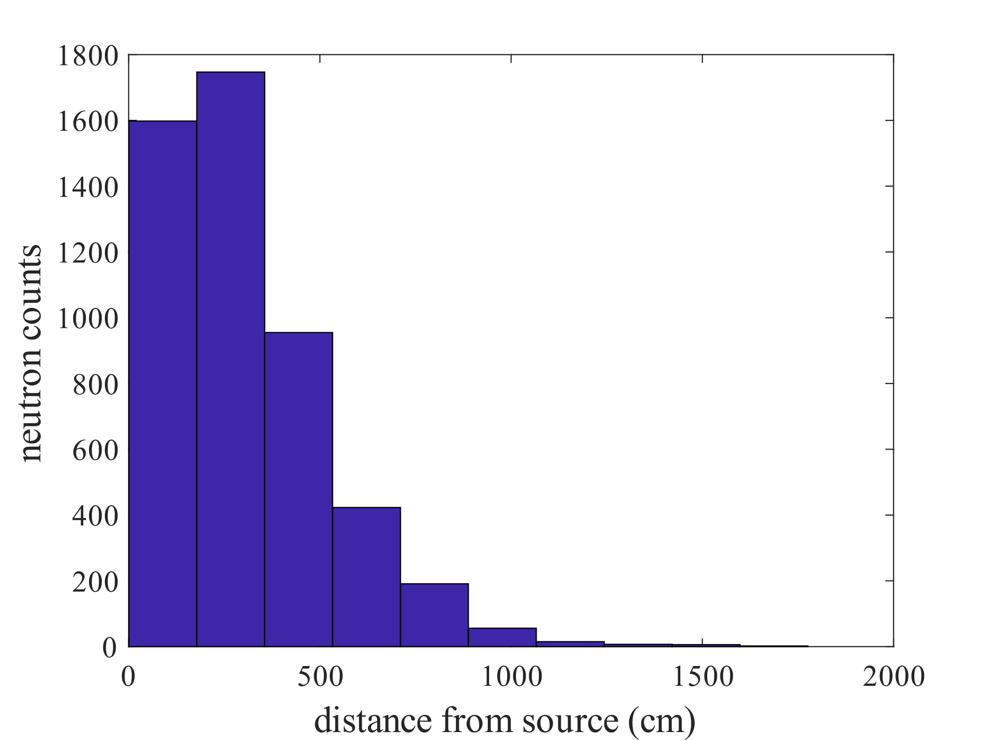
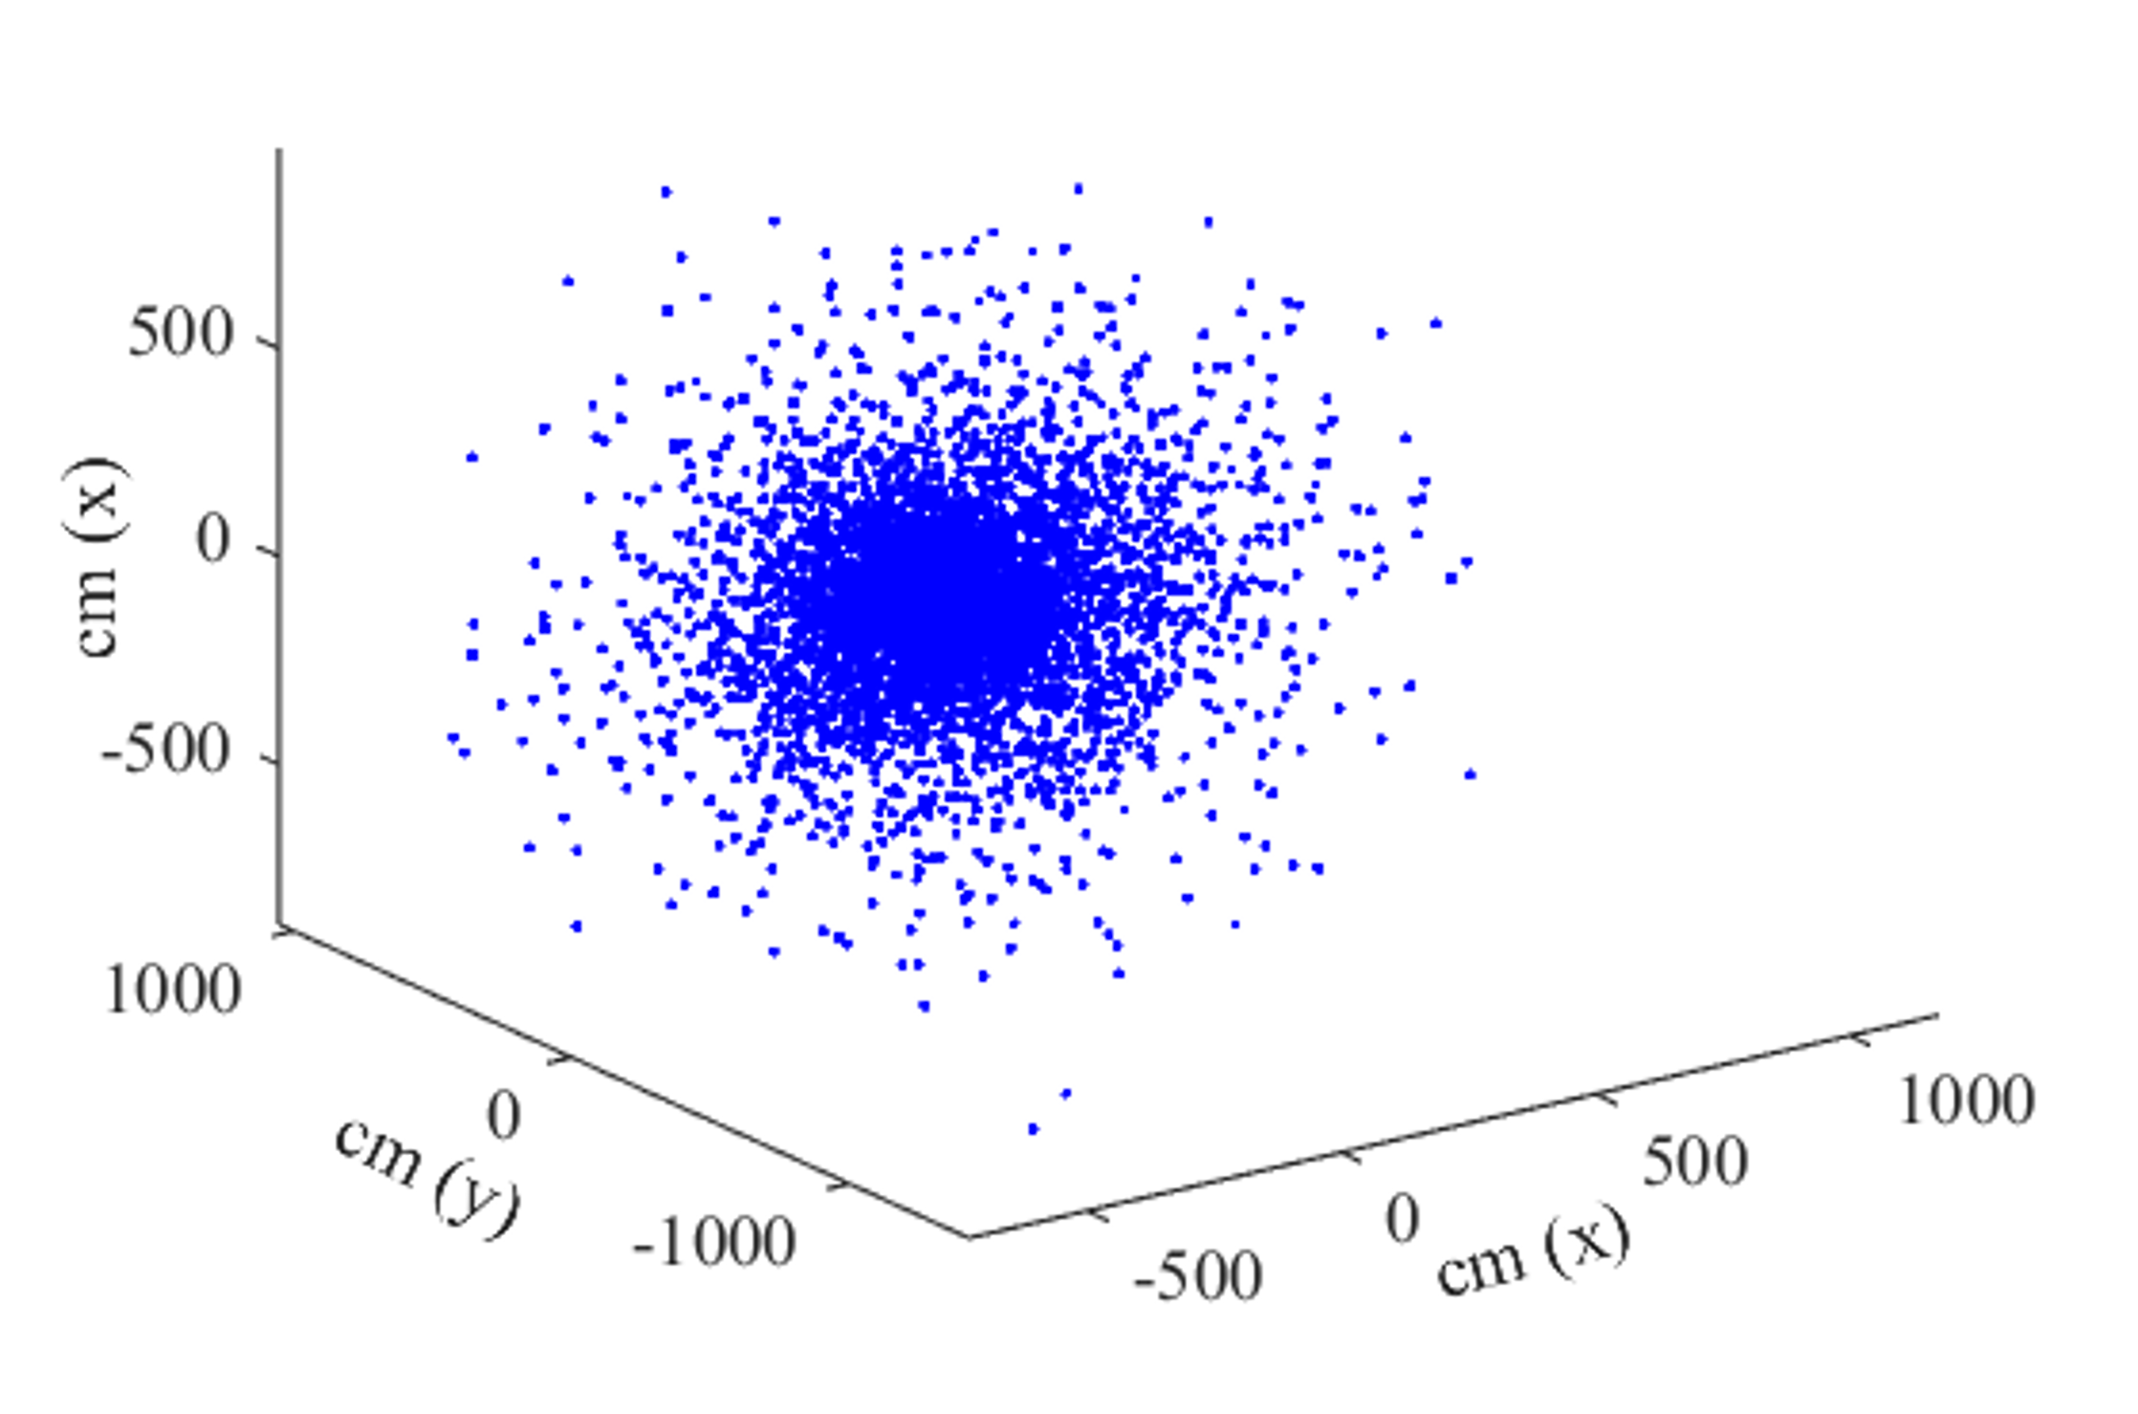
Spherical Source @ (r = 1cm & c:[0,0,0]): D₂O
MC simulation for 5K neutrons, for 25 such data:
Scattering counts before absorption (aka n history): 8771.5681 ± 146.0955
Mean of neutron distance: 308.1092 ± 3.6943 cm
Maximum neutron distance: 1925.7930 ± 313.9405 cm
Maximum neutron counts

Slide 9
Results & Discussions:
 | N History | Mean N Distance | N History | Mean N Distance
Source ↓ | H₂O |  | D₂O
Point | 68.27 ± 0.72 | 6.27 ± 0.05 cm | 8795.19 ± 138.09 | 308.53 ± 2.80 cm
Cylinder | 68.35 ± 1.01 | 6.28 ± 0.06 cm | 8771.13 ± 117.25 | 308.15 ± 3.19 cm
Spherical | 68.44 ± 0.94 | 6.29 ± 0.05 cm | 8771.57 ± 146.09 | 308.11 ± 3.69 cm
Inferences:
Moderator plays a dominant role in neutron transport. D₂O enables over 100x more scatterings and 50x longer travel than H₂O.
The geometry of the neutron source has minimal effect on the overall scattering statistics and mean travel distances in a homogeneous medium.
The results align with theoretical expectations from cross-section and mean free path data derived from JANIS.

